Slide 1

Mobile robot obstacle avoidance
Sina Rabiee
Alireza Faghih Aliabadi
Moein Nasiri

Slide 2

Outline
Data Generation
Sensor reading
Filtering & Disturbance Rejection
Creating a Data Frame
Normalization
Simulation and Generated paths
Kinematics Equations
Proposed paths for training
Creating a Data Frame
Identification
SysIdentPy
Preparing Time series
Keras model (MLP)
Evaluation and Testing
Saving layer weights and model
Controller
Data Manipulation and Preparation
Keras model (LSTM)
Evaluation and Testing
Saving layer weights and model

Slide 3
Data Generation

Slide 4
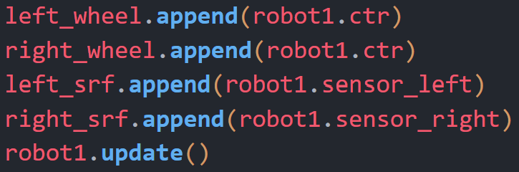
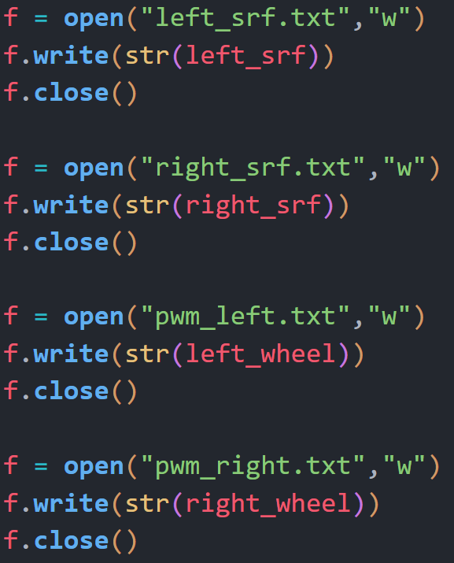
Data Generation
Sensor reading
Reading Data from ultrasonic sensors every 0.1s and appending in a list
Writing lists in .txt files

Slide 5
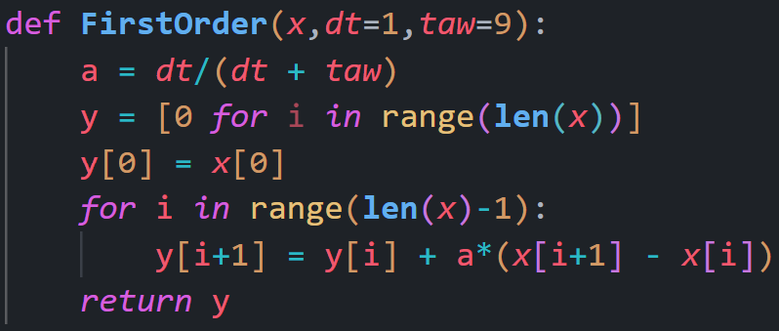
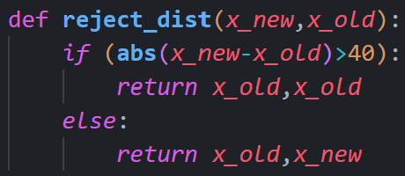
Data Generation
Filtering & Disturbance Rejection
Using a simple first order filter or complementary filter to damp the changes in sensor readings
Left sensor readings example:
[0, 236, 278, 277, 275, 274, 271, 82, 73, 335, 79, 75, 66, 63, 61, 60, 58, 64, 53, 51, 56, 52, 55, 44, 255, 244, 241, 46, 236, 234, 229, 97, 225, 223, 220, 217, 214, 212, 210, 209]
Using a simple if condition to discard huge disturbance
[100, 93, 90, 89, 87, 83, 80, 79, 77, 76, 75, 66, 63, 61, 60, 58, 55, 53, 51, 53, 54, 55, 57, 60, 65, 70, 74, 79, 83, 89, 97, 225, 223, 220, 217, 214, 212, 210, 209]
Removing undesired data with hand!

Slide 6
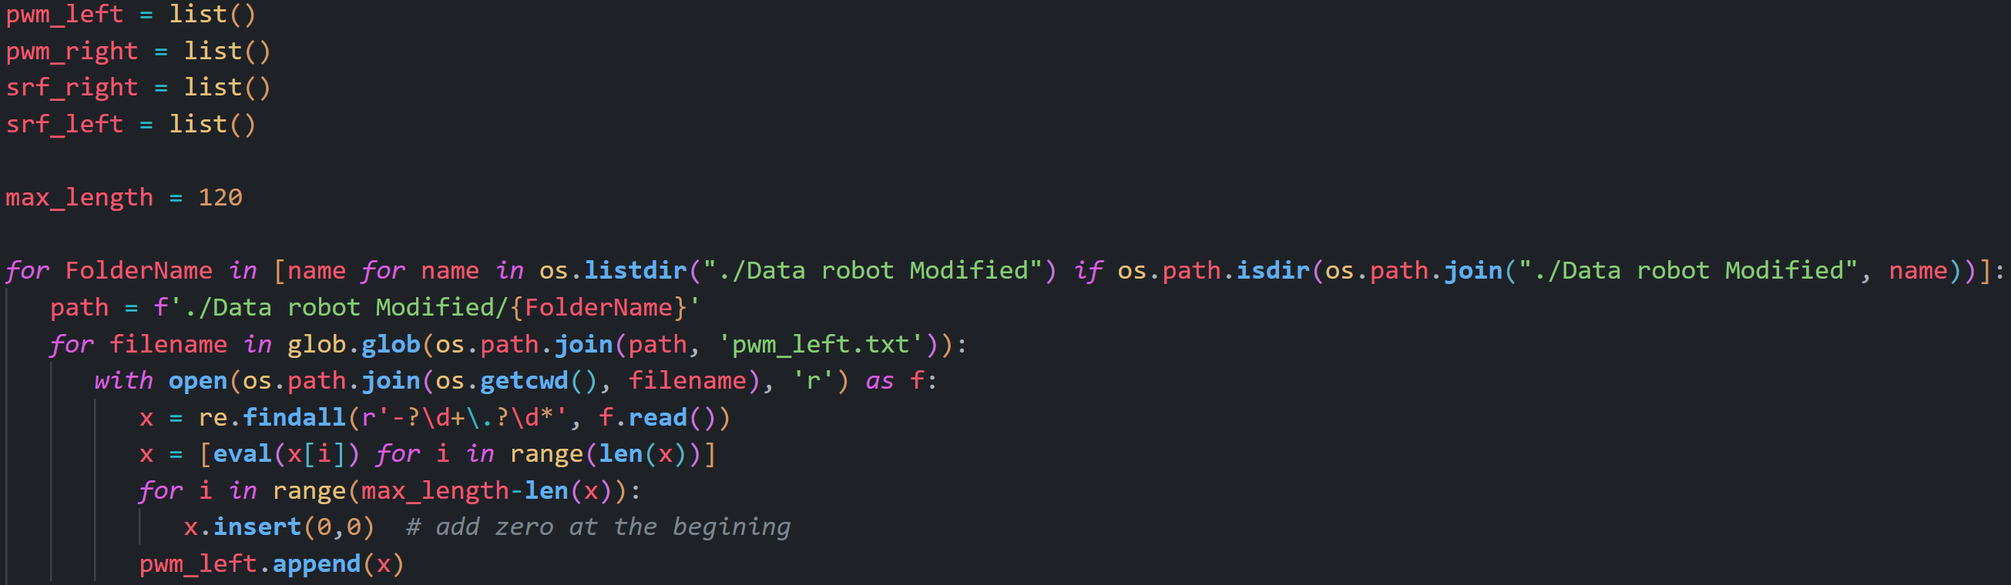
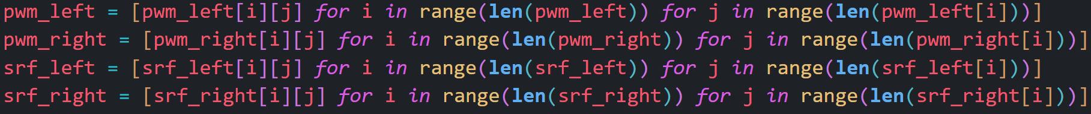
Data Generation
Creating a Data Frame
Reading .txt files, pad them to the same length and appending them in related lists
Flatten 2D lists

Slide 7
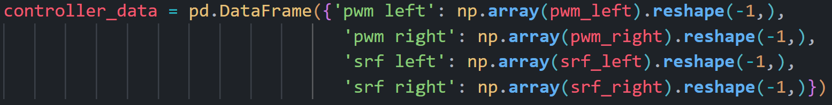
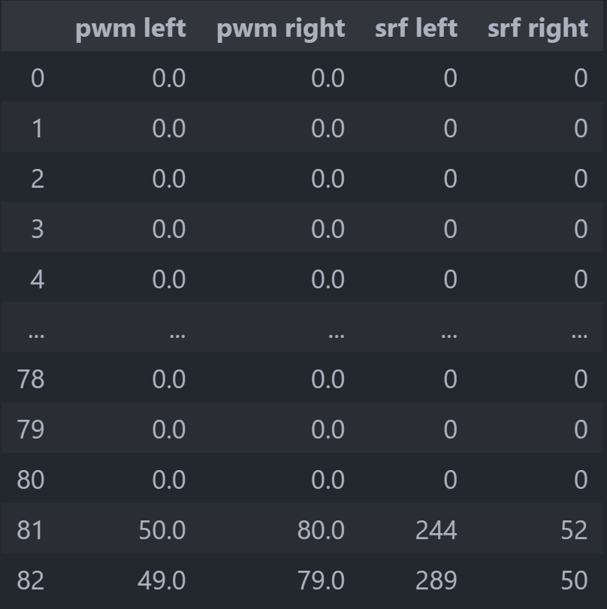
Data Generation
Creating a Data Frame
Using pandas to create a Data Frame for controller NN training

Slide 8
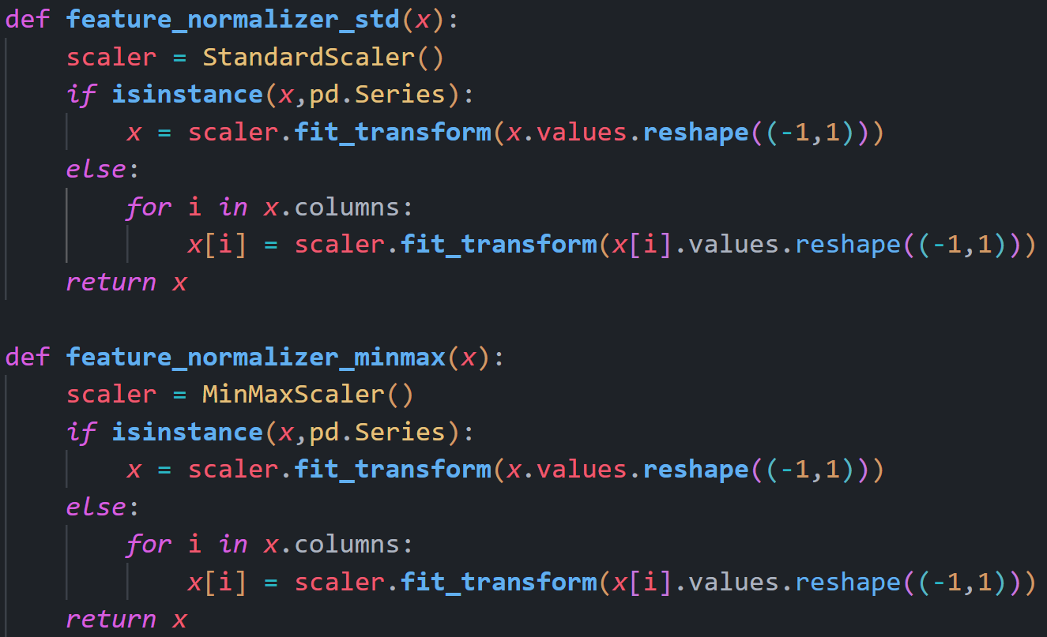
Data Generation
Normalization
Using Scikit-learn Library for normalizing dataset
Two methods for normalization: Standard Scaling (more suitable for signed data)
Min Max Scaling (didn’t get good results)

Slide 9
Simulation and Generated Paths

Slide 10
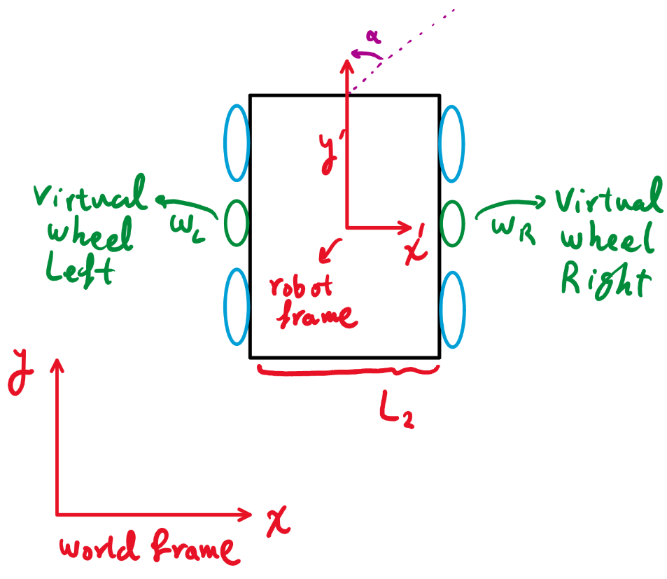
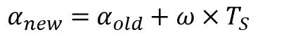
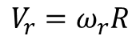
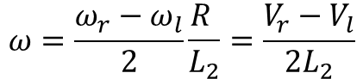
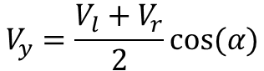
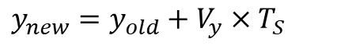
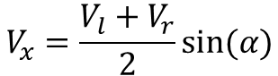
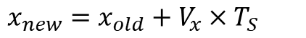
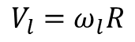
Simulation and Generated paths
Kinematics Equations
$$V_{r}=ω_{r}R$$
$$V_{l}=ω_{l}R$$
$$V_{x}=\frac{V_{l}+V_{r}}{2}sin⁡(α)$$
$$V_{y}=\frac{V_{l}+V_{r}}{2}cos⁡(α)$$
$$ω=\frac{ω_{r}−ω_{l}}{2}\frac{R }{L_{2}}=\frac{V_{r}−V_{l}}{2L_{2}}$$
$α_{new}=$ $α_{old}+$ $ω×T_{S}$
$x_{new}=x_{old}+V_{x}×T_{S}$
$y_{new}=y_{old}+V_{y}×T_{S}$

Slide 11
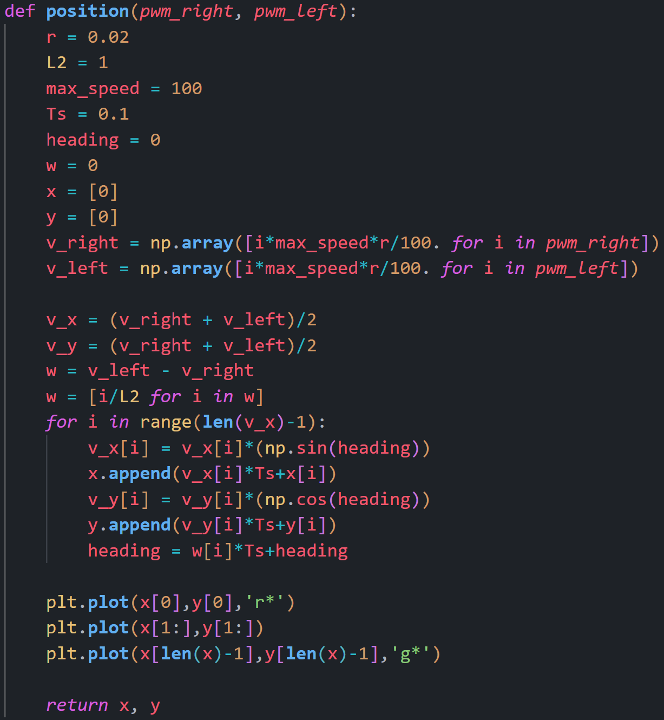
Simulation and Generated paths
Kinematics Equations

Slide 12
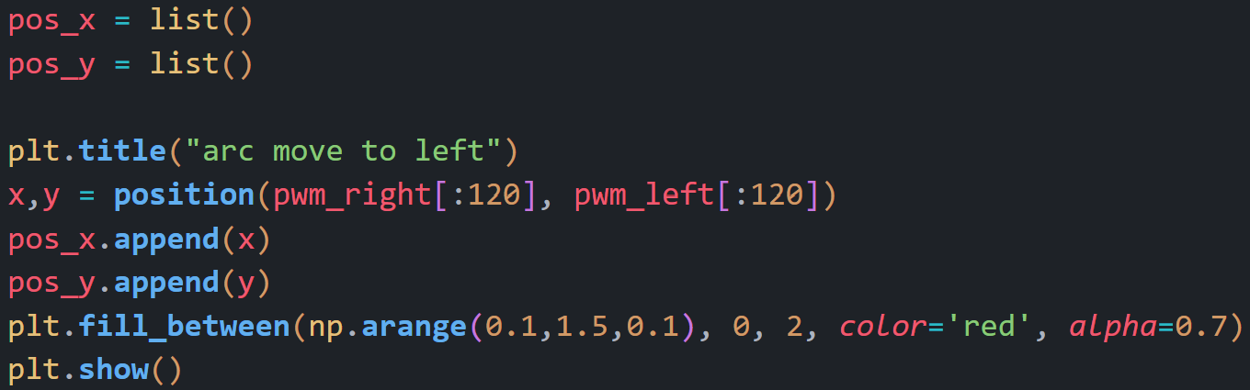
Simulation and Generated paths
Proposed paths for training
Using the previous function to calculate the coordinates of the robot and append the in lists

Slide 13
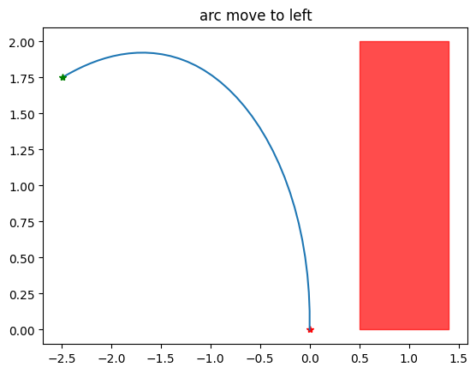
Simulation and Generated paths
Proposed paths for training
Arc move to left

Slide 14
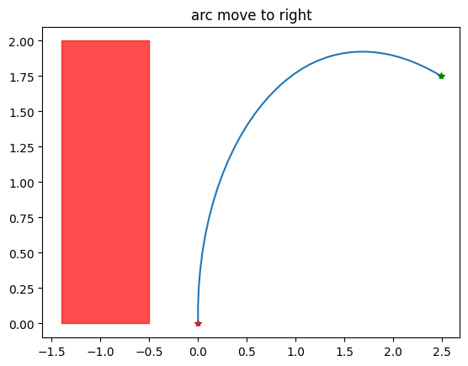
Simulation and Generated paths
Proposed paths for training
Arc move to right

Slide 15
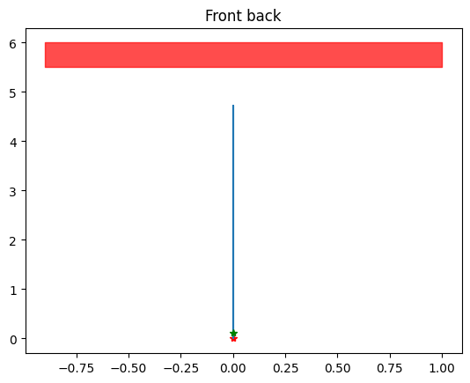
Simulation and Generated paths
Proposed paths for training
Front/Back

Slide 16
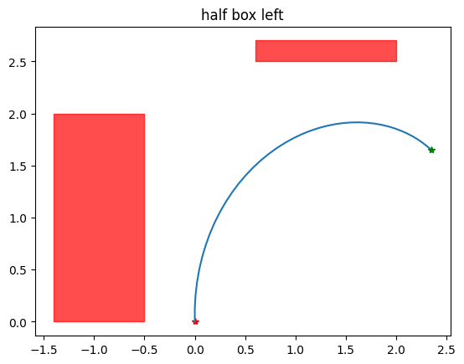
Simulation and Generated paths
Proposed paths for training
Half box left

Slide 17
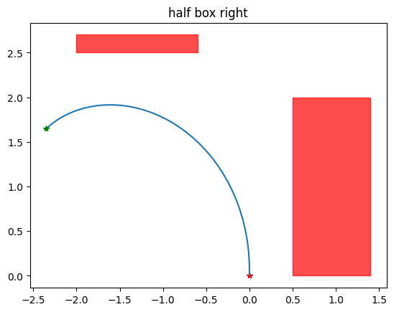
Simulation and Generated paths
Proposed paths for training
Half box right

Slide 18
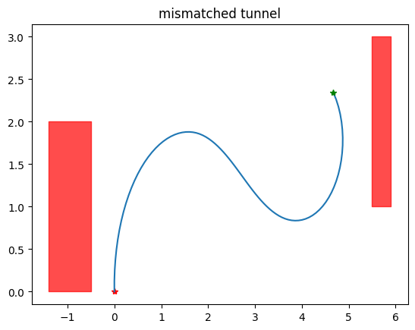
Simulation and Generated paths
Proposed paths for training
Mismatched Tunnel

Slide 19
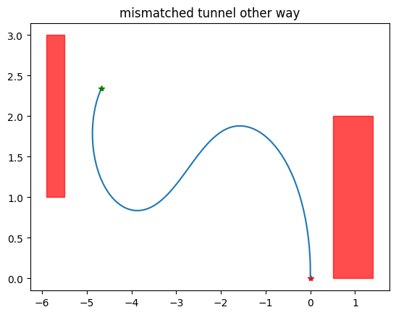
Simulation and Generated paths
Proposed paths for training
Mismatched Tunnel other way

Slide 20
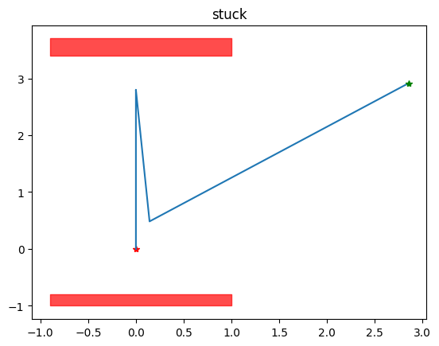
Simulation and Generated paths
Proposed paths for training
Stuck

Slide 21
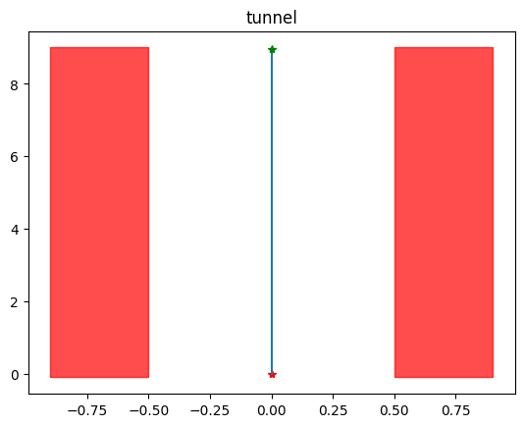
Simulation and Generated paths
Proposed paths for training
Tunnel

Slide 22
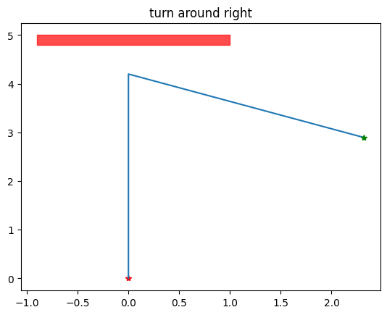
Simulation and Generated paths
Proposed paths for training
Turn around right

Slide 23
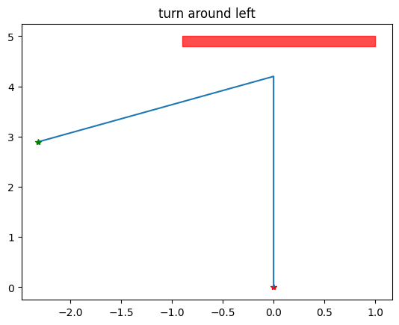
Simulation and Generated paths
Proposed paths for training
Turn around left

Slide 24
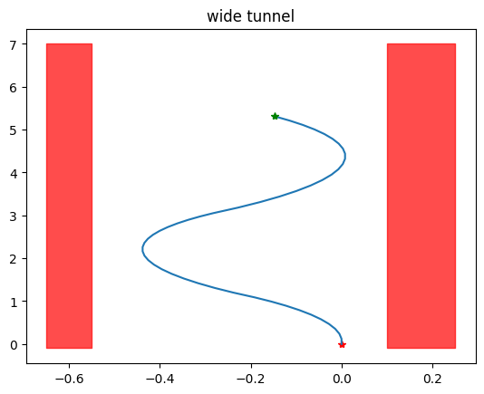
Simulation and Generated paths
Proposed paths for training
Wide tunnel

Slide 25
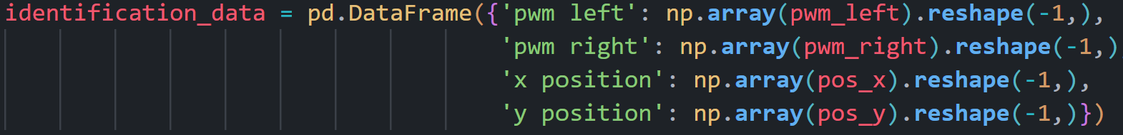
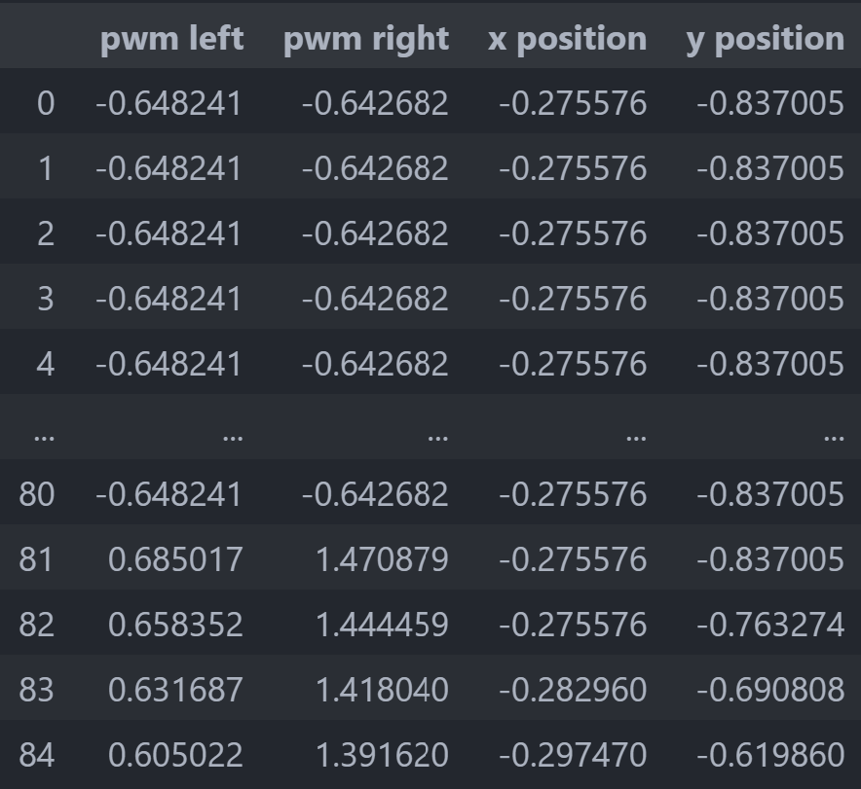
Simulation and Generated paths
Creating a Data Frame
Placing the resulting lists in a Data Frame and normalize it for training

Slide 26
System Identification

Slide 27

Identification
SysIdentPy

Slide 28
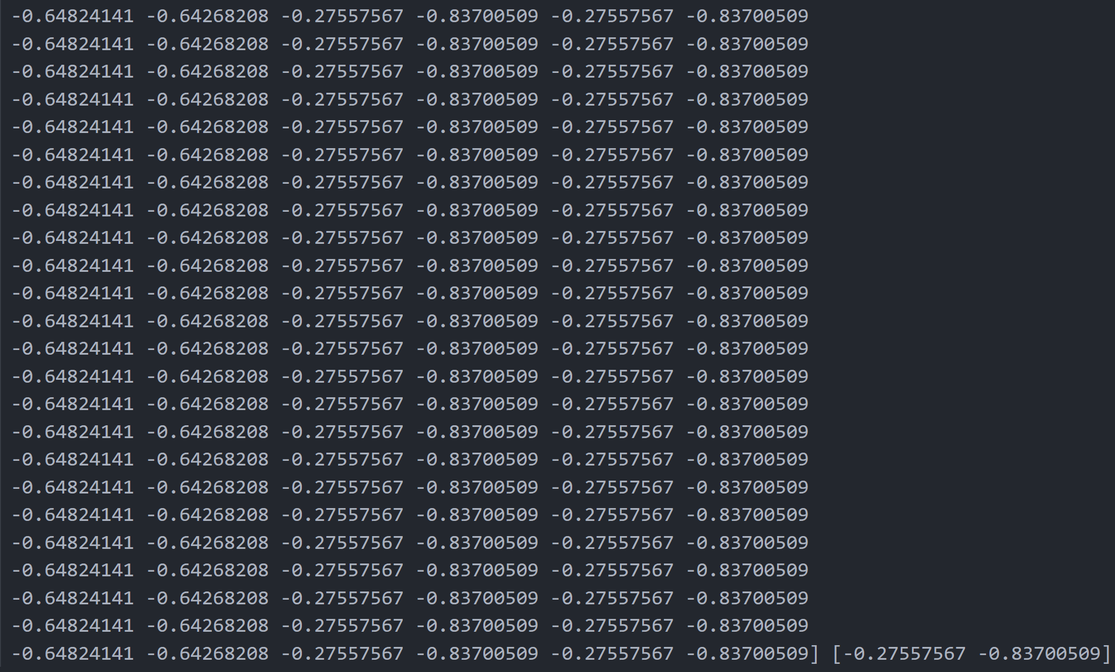
Identification
Preparing Time series
The dataset In hand is a time series in nature, so are to prepare it accordingly:
Inputs: PWM of the virtual wheels and coordinates of the last time step
output: X-Y position of the current time step
Input dimension: time series with 4 attributes
output dimension: time series with 2 attributes

Slide 29
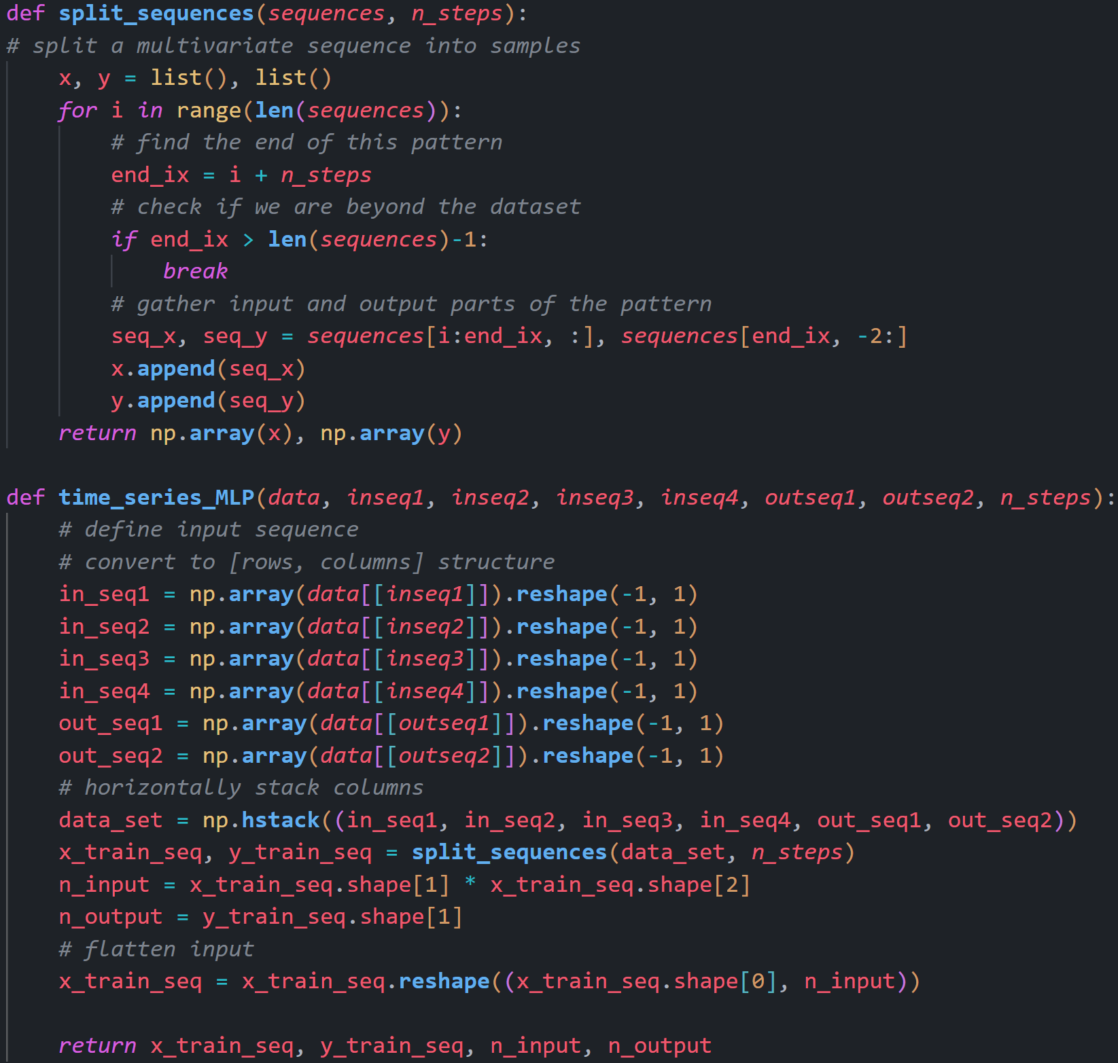
Identification
Preparing Time series

Slide 30
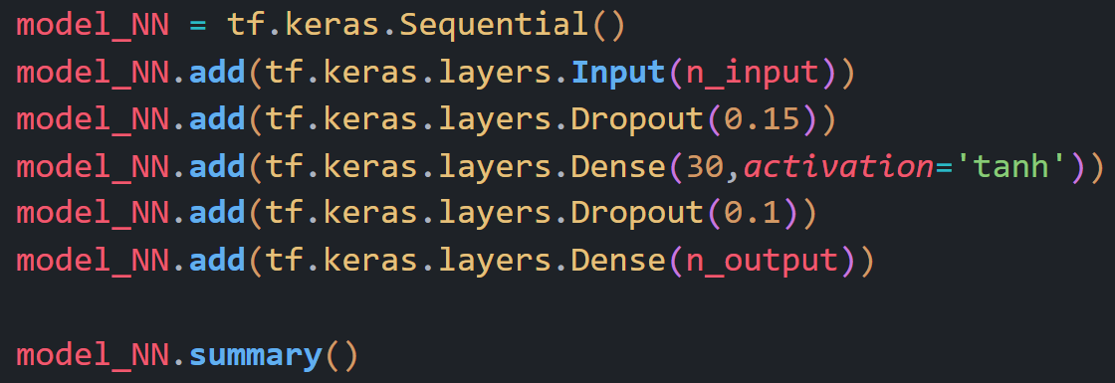
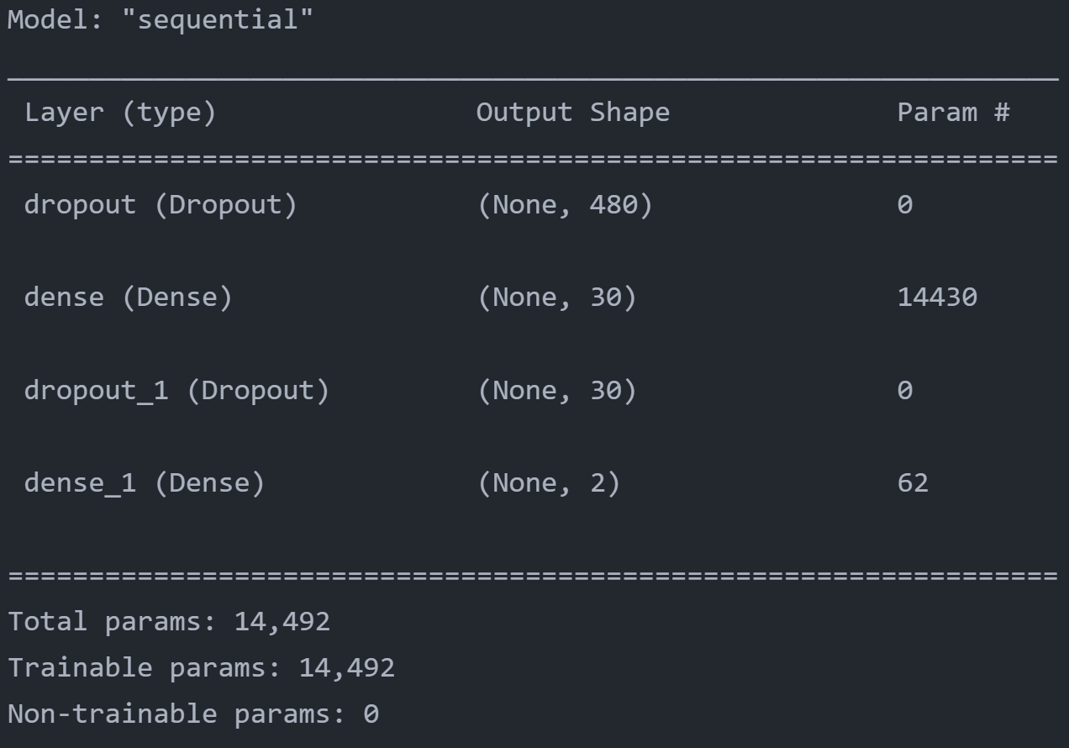
Identification
Keras model (MLP)
Keeping universal approximation theorem in mind, a 3 layer MLP (1 hidden Layer) is sufficient
for approximation of any function. using tanh as activation because input data is signed.
In tests, not using dropouts, caused the validation loss to be less than training loss!
One cause of this could be the huge dimension reduction from the input to the hidden layer.
Using dropout helps to generalize the model more than before.

Slide 31
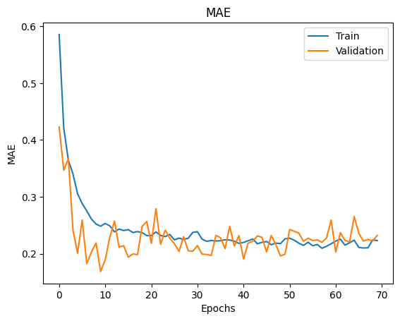
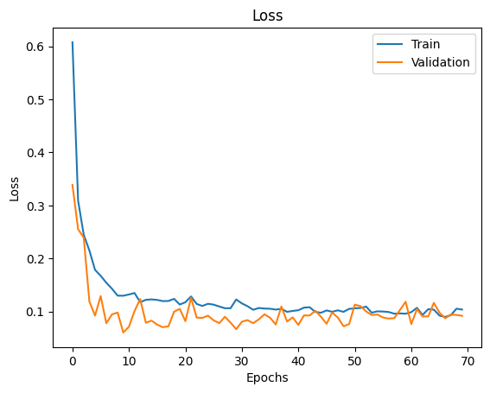
Identification
Keras model (MLP)

Slide 32
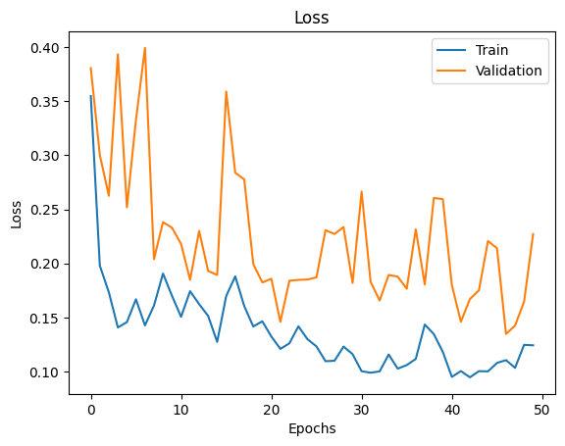
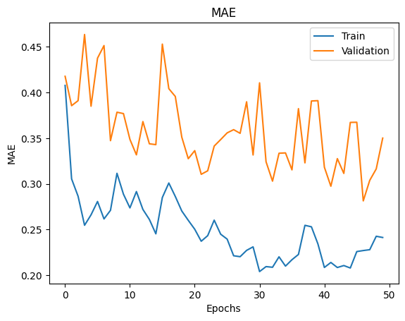
Identification
Keras model (without dropout)

Slide 33
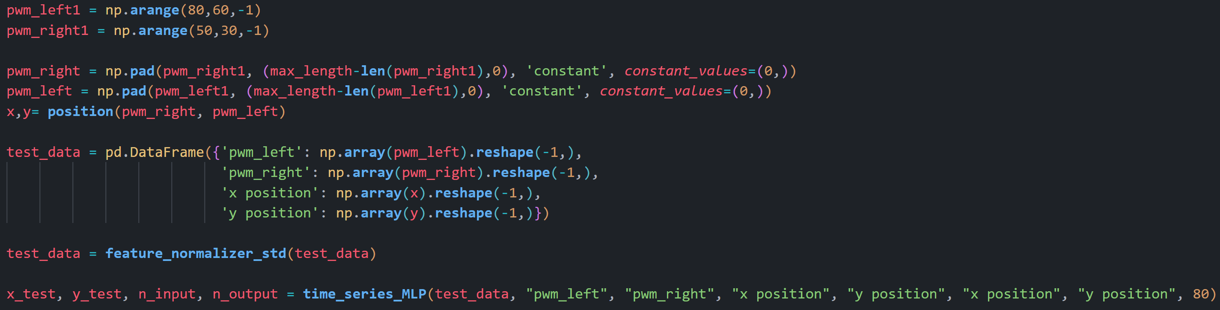
Identification
Evaluation and testing
Creating a random test path and pre-process it the same way

Slide 34
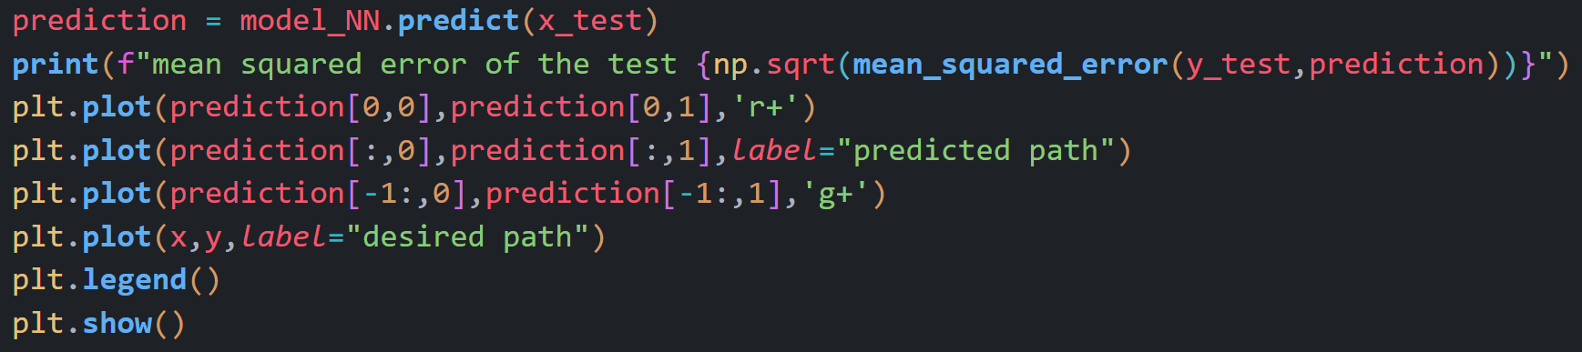
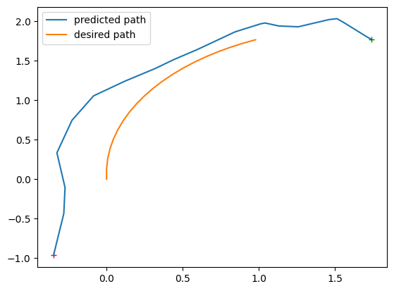
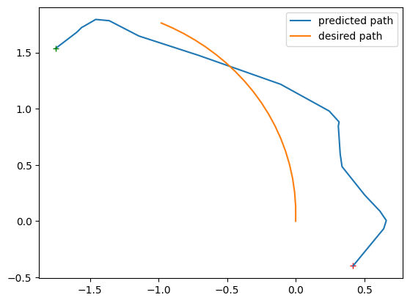
Identification
Evaluation and testing

Slide 35
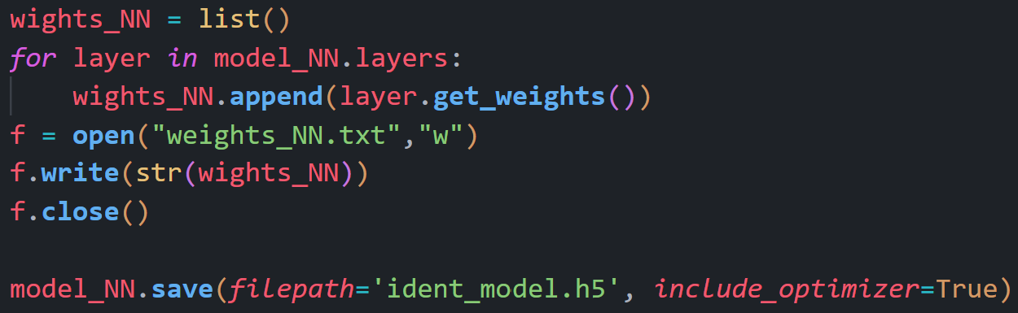
Identification
Saving layer weights and model

Slide 36
Controller

Slide 37
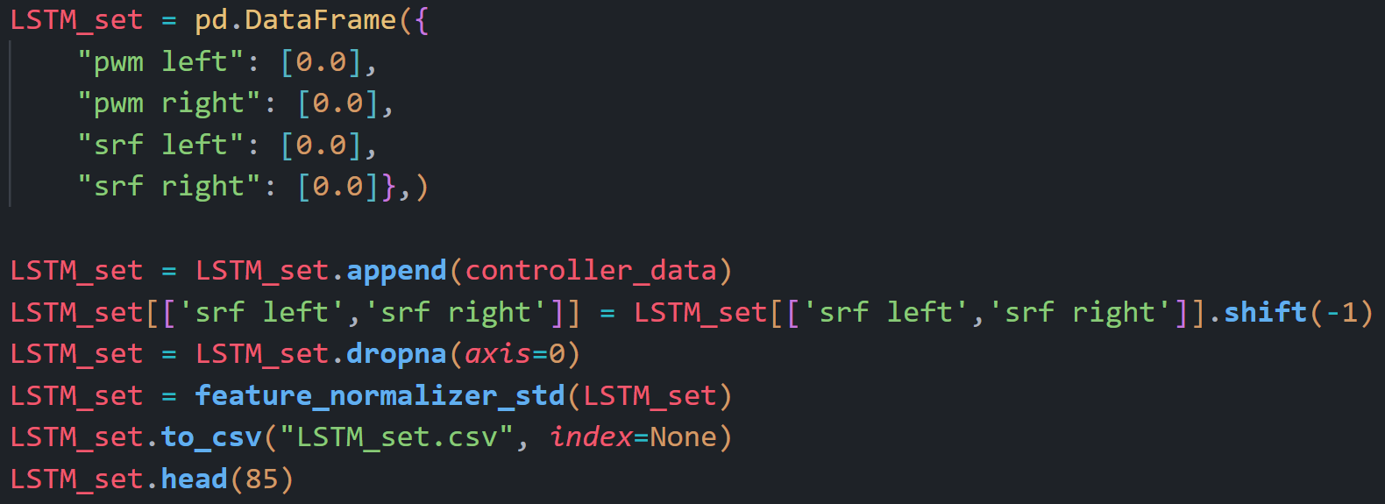
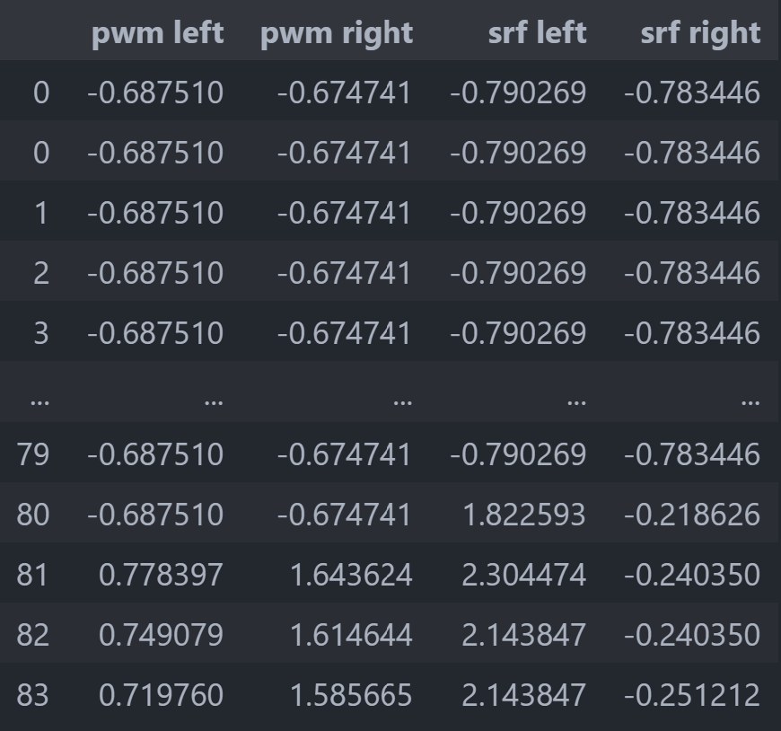
Controller
Data Manipulation and Preparation
Each row in the created dataset for controller contains PWM of the virtual wheels and sensor readings of the same time step. So we need to shift the sensor values one row up.

Slide 38
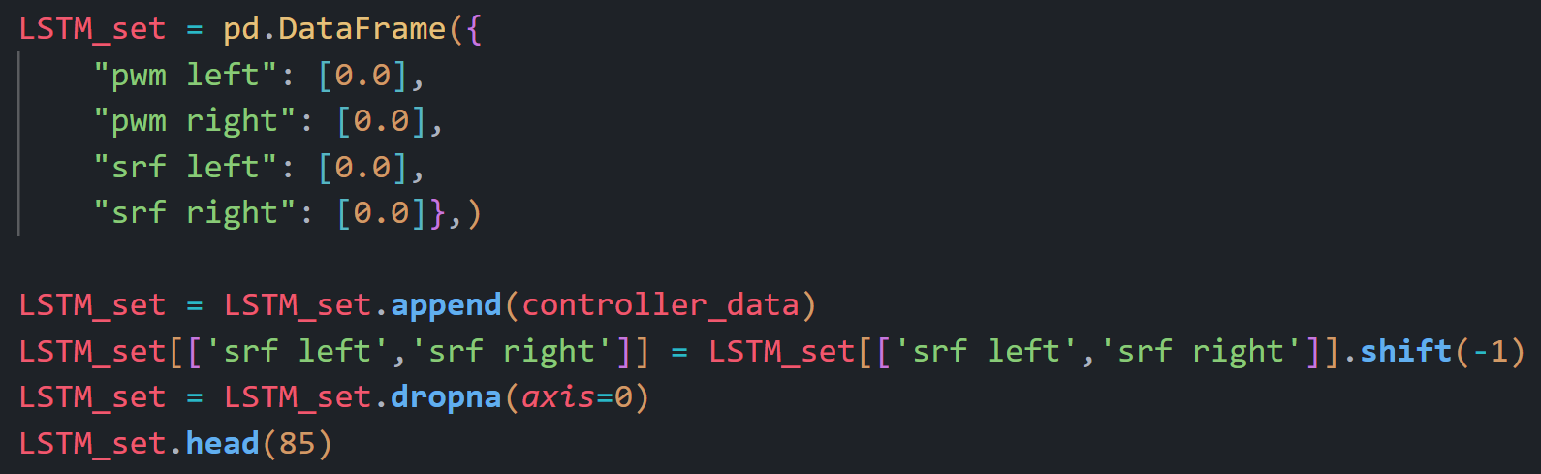

Controller
Data Manipulation and Preparation (without normalization)

Slide 39


Controller
Data Manipulation and Preparation
As before we need to create time series from the data. For LSTM model we create time series of 4 inputs (sensor reading of the previous time step and PWM values of the current time step) in each time step.
Concatenating to PWM values of the next time step in list, prepares the output for training.

Slide 40

Controller
Data Manipulation and Preparation
Inputs to the LSTM (cumulative_input_vectors) must be of the same length. So padding is necessary.

Slide 41

Controller
Data Manipulation and Preparation
Inputs needs to be reshaped into a 3D array (LSTM requires 3 dimensions)

Slide 42


Controller
Keras model (LSTM)
We are using a raspberry pi 3 as the computer on the robot. Because of this the network used for the controller must e simple and light. We use a LSTM layer coupled with a dense layer with 2 neurons (same number of neurons as the output dimension).

Slide 43


Identification
Keras model (MLP)

Slide 44


Controller
Keras model (overfitted)

Slide 45

Controller
Evaluation and testing
Creating a random test path and pre-process it the same way

Slide 46

Controller
Evaluation and testing (Avoiding an obstacle on the left)

Slide 47

Controller
Evaluation and testing (Avoiding an obstacle on the right)

Slide 48

Controller
Evaluation and testing (Both sensors reading noisy large outputs)
Robots moves slowly (pay attention to scales of the axis) but in a random direction

Slide 49

Controller
Evaluation and testing (Avoiding an uneven obstacle course)

Slide 50

Controller
Saving layer weights and model

